Slide 1
Is the hippocampus a predictive learning system?
Randall C. O’Reilly
UC Davis, eCortex Inc, Astera Obelisk Lab

Slide 2
Long history of predictive theories
Gray, 1982; Vinogradova, 2001; Lisman & Grace, 2005: scalar mismatch between prediction and actual:
“it is proposed that … the septo-hippocampal system (SHS) acts as a comparator: it compares predicted to actual sensory events and activates the outputs of the BIS when there is a mismatch or when the predicted event is aversive”
Levy, 1996; Wallenstein & Hasselmo, 1997; Jensen & Lisman, 1996; Tsodyks et al, 1996; Rolls, 2013; Schapiro et al, 2017; Stachenfeld et al, 2017: predict next step(s) in sequence:
“We argue instead that the [hippocampal] map is essentially predictive, encoding expectations about an animal’s future state. This view resonates with earlier ideas about the predictive function of the hippocampus [lots of additional cites]

Slide 3
Reward Prediction Error (RPE; DA) -> Hip
Sinclair et al & Barense (2019, 2021): Prediction errors disrupt hippocampal reps and update episodic memories:
“The brain supports adaptive behavior by generating predictions, learning from errors, and updating memories to accommodate new information. Prediction error, or surprise, triggers learning when reality contradicts expectations. Prior studies have shown that the hippocampus signals prediction error…”
Review: Ergo, De Loof & Verguts (2020): extensive evidence for RPE effects on “declarative memory”

Slide 4
Episodic memory and the hippocampus
Dominant theory, extensive data (e.g., HM): Hippocampus binds temporal context and other content to form distinct, pattern separated representations of episodes (events)
What is an event?
Zacks et al (2007):
“Perceptual systems continuously make predictions about what will happen next. When transient errors in predictions arise, an event boundary is perceived”

Slide 5
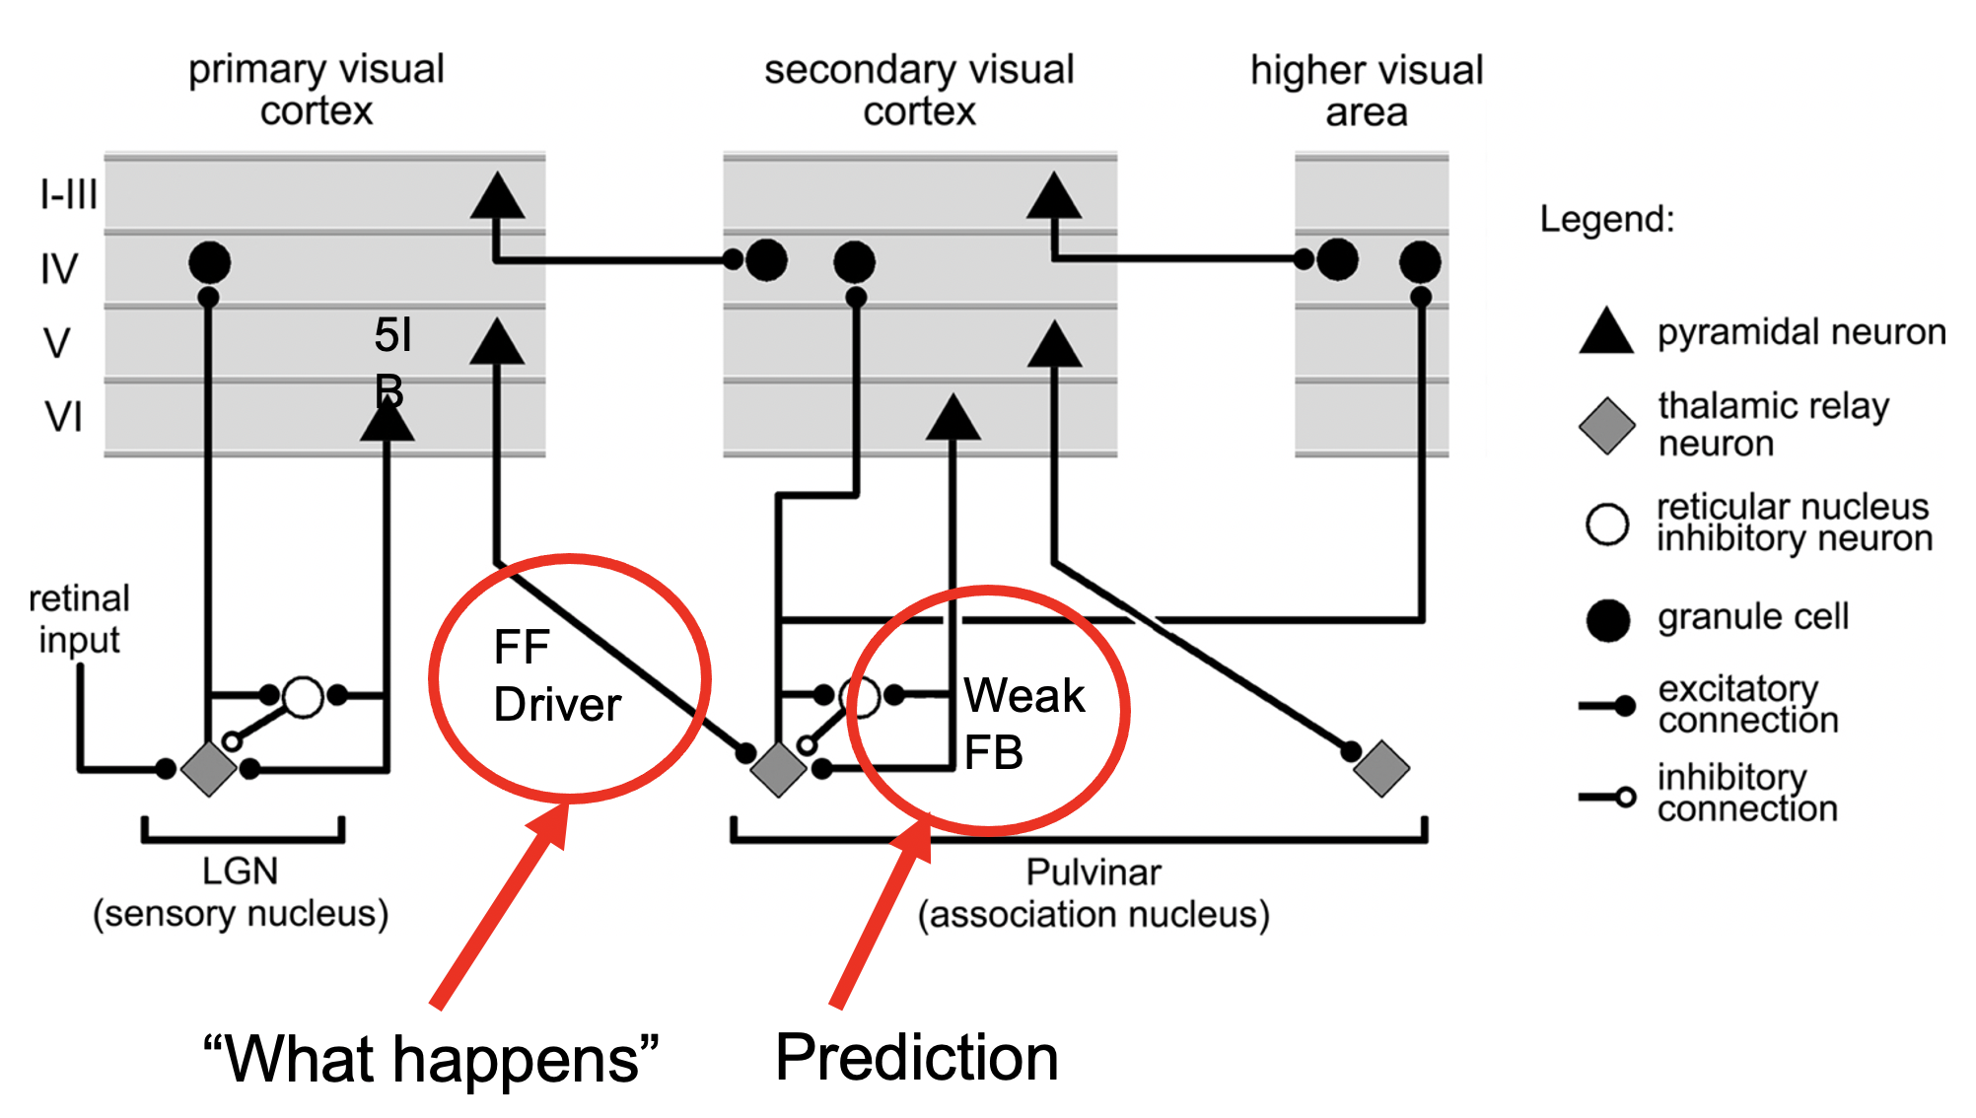
Predictive learning in Neocortex & Pulvinar (O’Reilly et al, 2021)
Pulvinar!

Slide 6
Key questions
Sensory cortex can predict what happens next because: a) physics, b) it has extensive, systematic encoding of current and recent prior state at multiple levels of abstraction.
Claim: Hippocampus cannot predict very well because it has a highly reduced representation of lots of randomly related info and its job is to pattern separate to encode distinct memories of even similar events.

Slide 7
But what about preplay in rodents?
Turns out it is mostly retrospective, not prospective..
Gillespie et al & Loren Frank (2021): Hippocampal replay reflects specific past experiences rather than a plan for subsequent choice:
“hippocampal replay does not reliably relate to immediately subsequent choice in a spatial memory task. Instead, replay preferentially represents previous goals and places that have not been visited recently, suggesting a role in storing and updating memories rather than in directly guiding upcoming behavior.”

Slide 8
Novelty, Recall, Event Segmentation, etc
Hippocampus can easily signal familiar (recalled) vs. not: novelty OK. (it just has no idea what will happen next..)
Keeping episodes separate can benefit from prediction-derived event segmentation (predictions computed in neocortex, not hippocampus)

